Slide 1


Start Smart 1.0
3rd Grade
Lesson 1

Slide 2

ELD Objective
Students will be able to engage in a Constructive Conversation using the Constructive Conversation Skill of CREATE, by sharing ideas and taking turns based on a visual text with a partner.
Notes:
Today we are going to be introduced to the Constructive Conversation Skill that will help us communicate ideas that we create and learn from each other. That Constructive Conversation Skill is CREATE. When we create, we say what we think or notice about something. We will also establish conversation norms to ensure good listening and speaking skills.

Slide 3
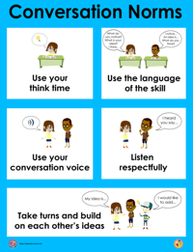
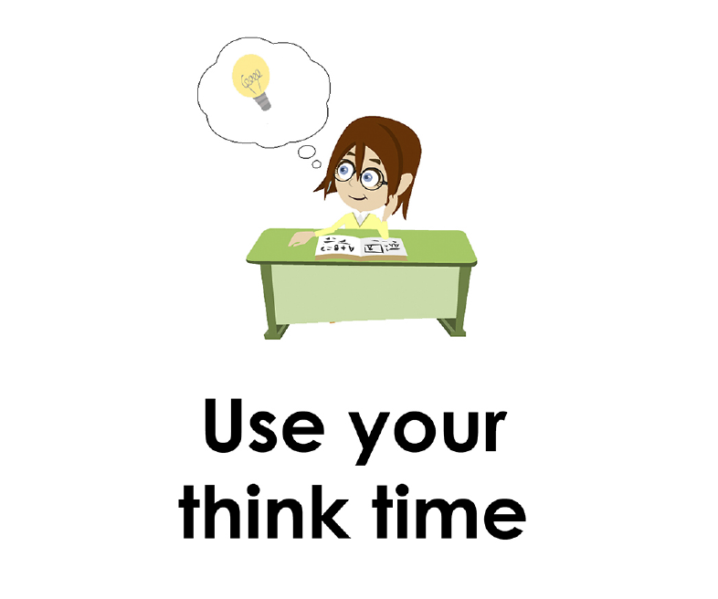
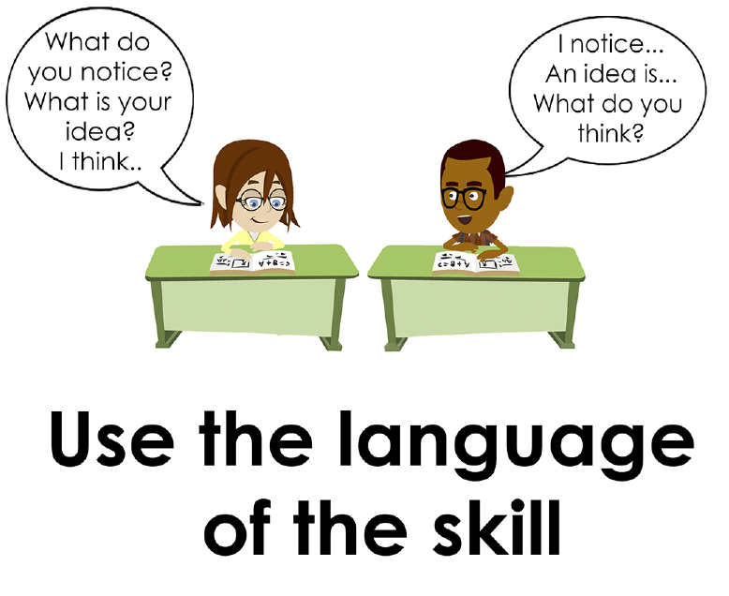
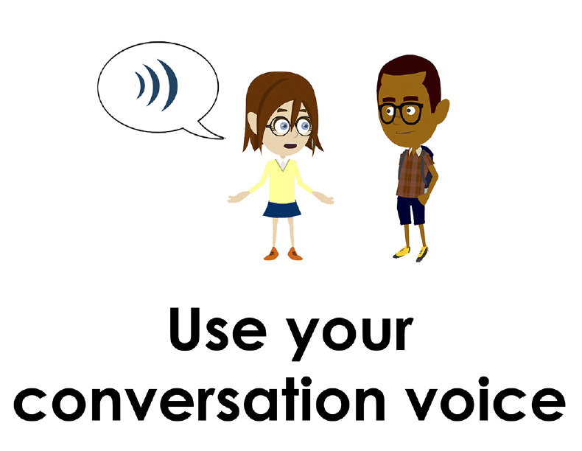
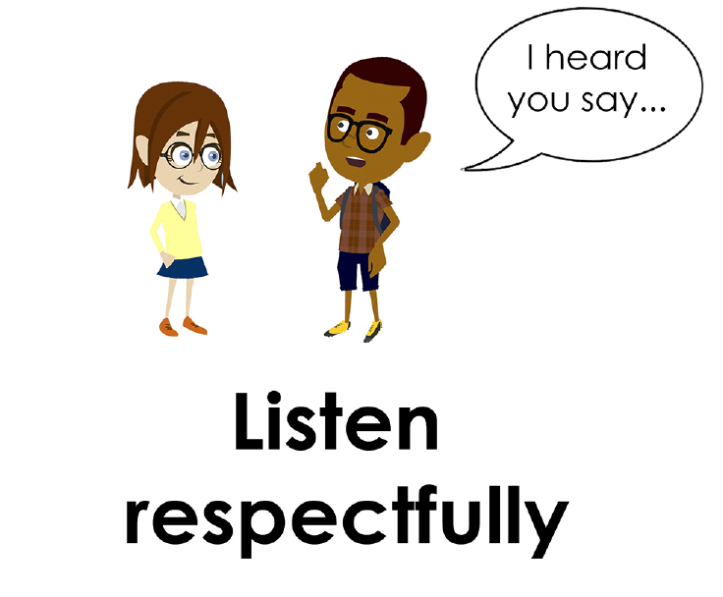
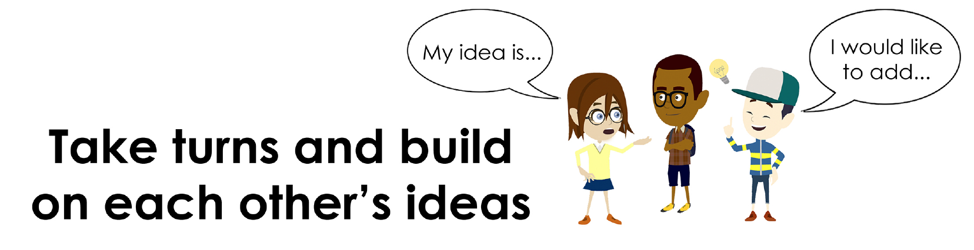
Conversation Norms Poster
  Use your think time
  Use the language of the skill
  Use your conversation voice
  Listen respectfully
  Take turns and build on each other’s ideas
Notes:
We will also establish norms to ensure good listening and speaking skills. Watch me as I model the five different conversation norms. Then you will debrief with your conversation partner by addressing the prompt: How did my partner and I demonstrate the conversation norms?
Use your think time
Say: First, we focus on and read the entire visual text. This means that we look at everything in the visual text. Then we take time to think about what we have read or seen and how it makes sense to us. In our minds, we think about the ideas we have. We might ask ourselves questions about the visual text. In our minds, we practice and say our ideas.
Demonstration: Teacher models looking at the visual text and examining it closely, nodding head, and placing index finger on the temple of his/her head to demonstrate think time.
Debrief:
Teacher: Talk with your partner. Answer the following prompt: How did I demonstrate think time? After a minute, bring the students back to share-out.
Targeted response: I saw your eyes on the text; you put your finger on your temple to show you were thinking.
Use the language of the skill
Say: First, we use the language of the skill (e.g., “My idea is,” “I think”) Then we share our ideas, we use the language of the skill to start our sentences and ask questions.
Demonstration: The teacher will select a student with whom to model the following script using the visual text selected:
Teacher: I notice…what do you notice?
Student: I notice…what do you notice?
Debrief:
Teacher: Talk with your partner. Answer the prompt: How did I use the language of the skill with my partner? After 1 minute, bring the students back to share-out.
Targeted Response: I heard the teacher and partner using the response starter, “I notice.”
Use your conversation voice
Say: Project your voice and speak clearly.
Demonstration: Teacher selects a student volunteer. They face each other and converse. The teacher uses a clear voice. The teacher and the student take turns and build on each other’s ideas.
Debrief:
Teacher: Talk with your partner. Answer the following prompt: How did my partner and I use our conversation voice? After 1 minute, bring the students back to share-out.
Targeted Response: The teacher used a clear voice; one person spoke at a time as they took turns.
Listen respectfully
Say: One way to let your partner know you are listening is to focus on your partner. Another way to let your partner know that you are listening to them is to restate, or say what your partner said. This shows respectful listening and helps you understand your partner.
Demonstration: The teacher lets the student begin the conversation using the visual text. The teacher nods and acknowledges. After the student shares, the teacher paraphrases what the student said with the following phrase: I heard you say…
Debrief:
Teacher: Talk with your partner. Answer the following prompt: How did my partner and I demonstrate respectful listening and restating? After 1 minute, bring the students back to share-out.
Targeted Response: After the first speaker stopped talking, the teacher (other partner) paraphrase what they said to show respectful listening.
Take turns and build on each other’s ideas
Say: To learn from each other, we have to share our best thinking. We listen carefully so we can add to and make our partner’s ideas clearer. Taking turns is everyone’s responsibility. The goal of Constructive Conversation is to learn from each other.
Demonstration: The teacher and a student volunteer model building on each other’s ideas using the visual text.
Debrief:
Teacher: Talk with your partner. Answer the following prompt: How did my partner and I demonstrate taking turns and building on each other’s ideas?
Targeted Response: Each partner took a turn and added to the other partner’s idea.

Slide 4
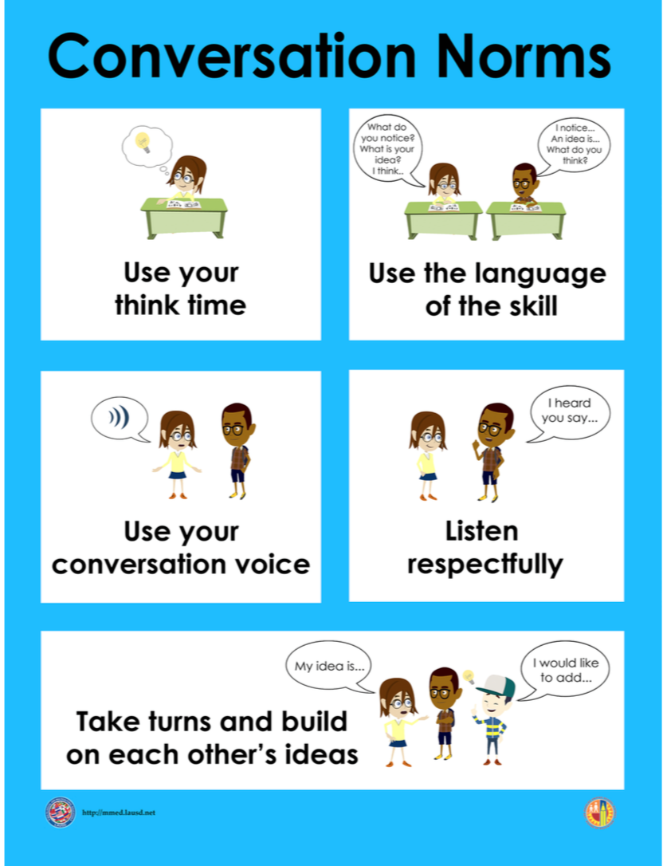
Notes:
We will also establish norms to ensure good listening and speaking skills. Watch me as I model the five different conversation norms. Then you will debrief with your conversation partner by addressing the prompt: How did my partner and I demonstrate the conversation norms?
Use your think time
Say: First, we focus on and read the entire visual text. This means that we look at everything in the visual text. Then we take time to think about what we have read or seen and how it makes sense to us. In our minds, we think about the ideas we have. We might ask ourselves questions about the visual text. In our minds, we practice and say our ideas.
Demonstration: Teacher models looking at the visual text and examining it closely, nodding head, and placing index finger on the temple of his/her head to demonstrate think time.
Debrief:
Teacher: Talk with your partner. Answer the following prompt: How did I demonstrate think time? After a minute, bring the students back to share-out.
Targeted response: I saw your eyes on the text; you put your finger on your temple to show you were thinking.
Use the language of the skill
Say: First, we use the language of the skill (e.g., “My idea is,” “I think”) Then we share our ideas, we use the language of the skill to start our sentences and ask questions.
Demonstration: The teacher will select a student with whom to model the following script using the visual text selected:
Teacher: I notice…what do you notice?
Student: I notice…what do you notice?
Debrief:
Teacher: Talk with your partner. Answer the prompt: How did I use the language of the skill with my partner? After 1 minute, bring the students back to share-out.
Targeted Response: I heard the teacher and partner using the response starter, “I notice.”
Use your conversation voice
Say: Project your voice and speak clearly.
Demonstration: Teacher selects a student volunteer. They face each other and converse. The teacher uses a clear voice. The teacher and the student take turns and build on each other’s ideas.
Debrief:
Teacher: Talk with your partner. Answer the following prompt: How did my partner and I use our conversation voice? After 1 minute, bring the students back to share-out.
Targeted Response: The teacher used a clear voice; one person spoke at a time as they took turns.
Listen respectfully
Say: One way to let your partner know you are listening is to focus on your partner. Another way to let your partner know that you are listening to them is to restate, or say what your partner said. This shows respectful listening and helps you understand your partner.
Demonstration: The teacher lets the student begin the conversation using the visual text. The teacher nods and acknowledges. After the student shares, the teacher paraphrases what the student said with the following phrase: I heard you say…
Debrief:
Teacher: Talk with your partner. Answer the following prompt: How did my partner and I demonstrate respectful listening and restating? After 1 minute, bring the students back to share-out.
Targeted Response: After the first speaker stopped talking, the teacher (other partner) paraphrase what they said to show respectful listening.
Take turns and build on each other’s ideas
Say: To learn from each other, we have to share our best thinking. We listen carefully so we can add to and make our partner’s ideas clearer. Taking turns is everyone’s responsibility. The goal of Constructive Conversation is to learn from each other.
Demonstration: The teacher and a student volunteer model building on each other’s ideas using the visual text.
Debrief:
Teacher: Talk with your partner. Answer the following prompt: How did my partner and I demonstrate taking turns and building on each other’s ideas?
Targeted Response: Each partner took a turn and added to the other partner’s idea.

Slide 5
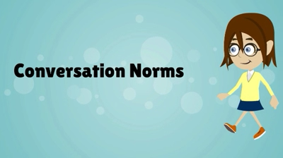
Conversation Norms
Notes:
Show Constructive Conversation Norms Video as a review of all norms

Slide 6
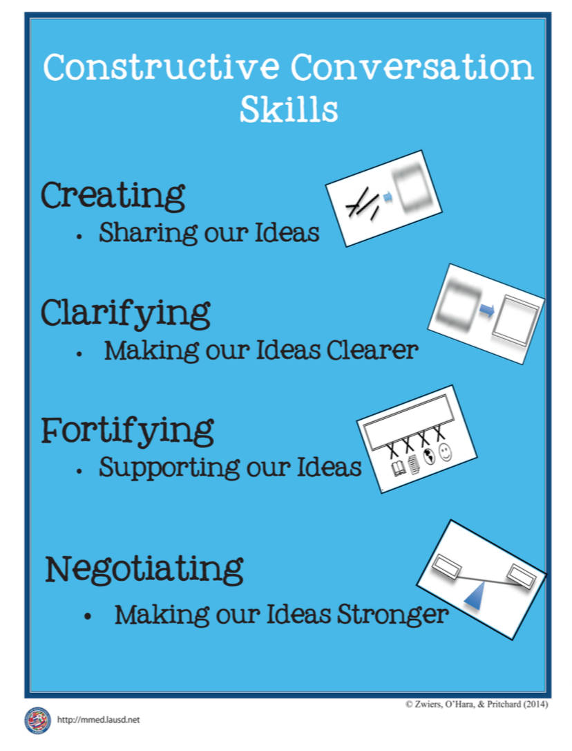
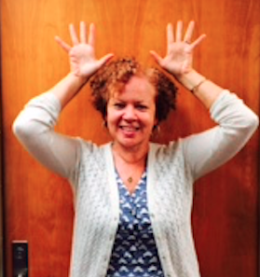
Hand Gesture and Phrase- CREATE
Sharing Our Ideas
Notes:
Introduce hand gesture for CREATE (teacher places her/his hands over her/his head and opens and closes his/her hands as if an idea is coming out of his/her head.)
To help us remember the skill that we are learning, we use a special phrase: “Sharing our ideas.”

Slide 7
Notes:
Introduce the Listening Task Poster
Teacher refers to the Listening Task Poster-­‐‑CREATE and read each step aloud. While you are listening to my partner and me, listen for the following:

Slide 8
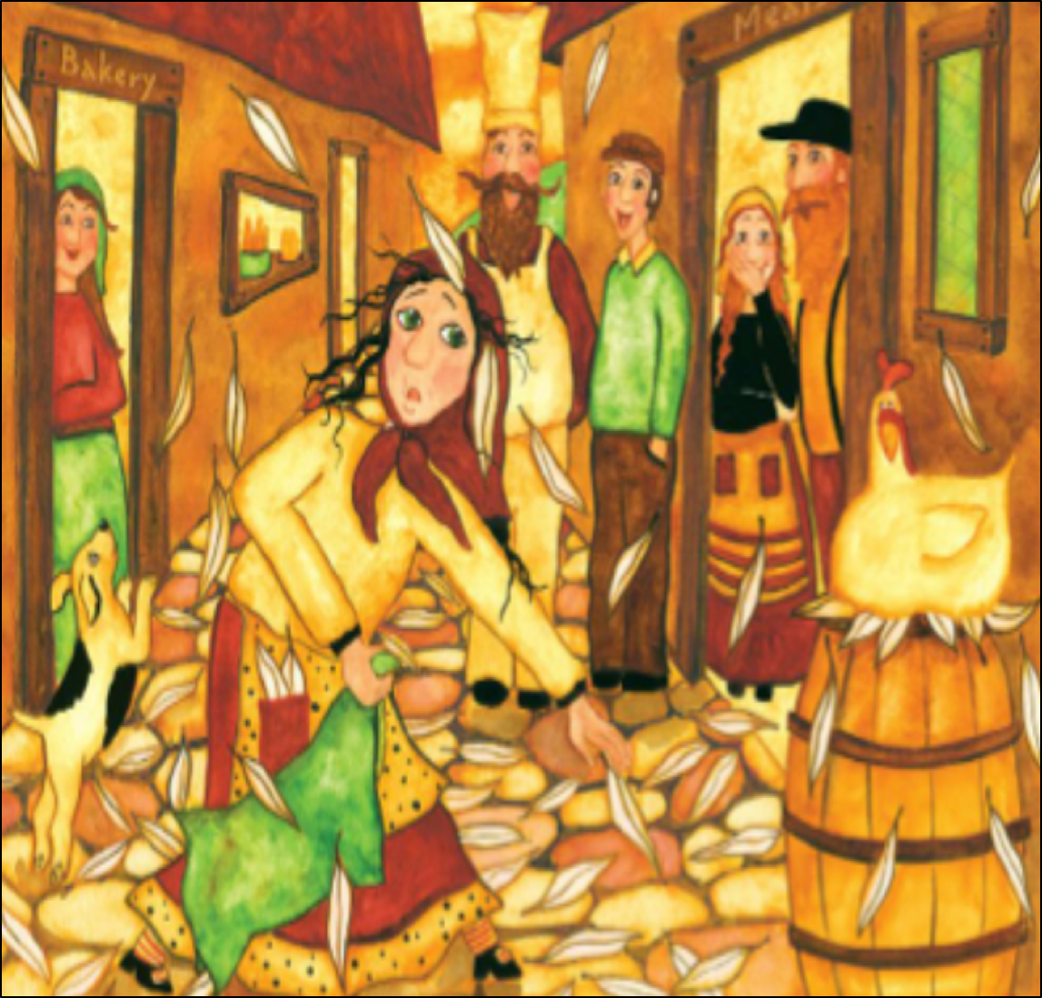
Prompt:
What do you notice in the visual text?
TEACHER VISUAL TEXT
Notes:
Display the Visual Text for Teacher Modeling. To model what a Constructive Conversation looks like we are going to use a visual text and address the prompt: What do you notice in the visual text? As we look at the visual text we will CREATE and share our own ideas.
Model using think time and pointing at key elements of the visual text
before reading the script.
Teacher will also discuss how the following norms were used during the conversation:
Use your think time
Use the language of the skill

Slide 9

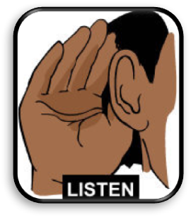
Listen to the Model Constructive Conversation
  Use your think time to study the visual text.
Listen actively to what two partners say to each other.
WHAT DO YOU NOTICE IN THE VISUAL TEXT? CITE DETAILS TO CLARIFY YOUR IDEAS.
Notes:
Audio of conversation plays automatically or provide a copy of the Model Script to the volunteer and allow time beforehand for student to review the script. Suggestions for reading the script:
● Show a video of students having the model conversation (optional)
● Student volunteer and teacher read model script
STUDENT LISTEN ACTIVELY

Slide 10
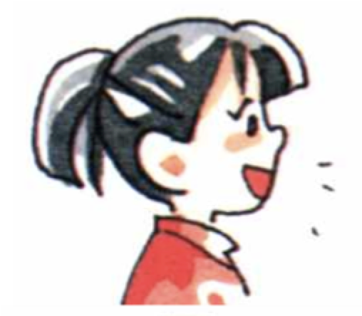
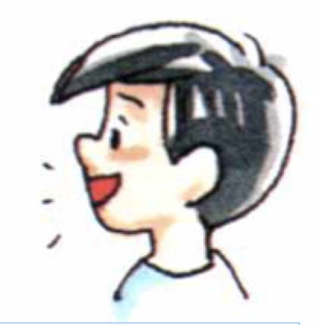
Visual Text Model
What do you notice in the visual text?
Partner A: I notice a woman picking up feathers. What do you notice?
Partner A: I notice the people standing at the back looking at the woman. What do you notice?
Partner A: I notice the woman is looking at the chicken. What else do you notice?
Partner A: I notice the dog is trying to catch the feathers. What do you notice?
Partner B: I notice a dog standing on its back legs jumping at the feathers. What do you notice?
Partner B: I notice there are feathers all over the floor. What else do you notice?
Partner B: I notice that the chicken is sitting on a pile of feathers that are on the barrel. The feathers are not the same as the chicken’s feathers. What do you notice?
Partner B: I notice the woman has two feathers in her pocket.
Notes:
Teacher will use questions, the Listening Task Poster and the Constructive Conversation Norms Poster to guide students through an analysis of what makes this a Model Constructive Conversation for the skill of CREATE. Teacher will also discuss how the following norms were used during the conversation:
Use your think time
Use the language of the skill

Slide 11
Notes:
Teacher refers to the Listening Task Poster-­‐‑CREATE and read each step aloud. While you are listening to my partner and me, listen for the following:

Slide 12
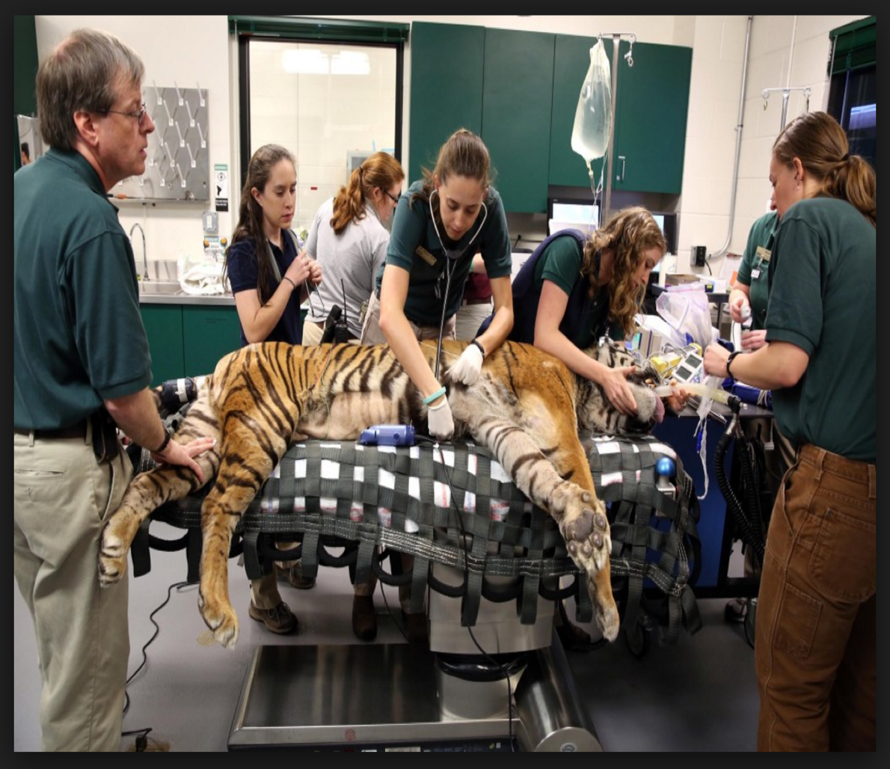
Listen to the Non-Model Constructive Conversation
  Use your think time to study the visual text.
Listen actively to what two partners say to each other.
WHAT DO YOU NOTICE IN THE VISUAL TEXT? CITE DETAILS TO CLARIFY YOUR IDEAS.
Notes:
Provide a copy of the Non-­‐‑Model Script to the volunteer and allow time beforehand for student to review the script. Suggestions for reading the script:
● Show a video of students having the model conversation (optional)
● Student volunteer and teacher read model script
STUDENT LISTEN ACTIVELY

Slide 13
Visual Text Non-Model
What do you notice in the visual text?
Partner A: I see a chicken.
Partner A: I see a dog too.
Partner A: There are chicken feathers.
Partner B: I see a chicken, too.
Partner B: There is a chicken.
Partner B: I love chicken nuggets from McDonald’s.
Notes:
Teacher will use questions, the Listening Task Poster and the Conversation Norms Poster to guide students through an analysis of what makes this a Non-­‐‑Model Constructive Conversation for the skill of CREATE. Teacher will also discuss how the following norms were used during the conversation:
Use your think time
Use the language of the skill

Slide 14
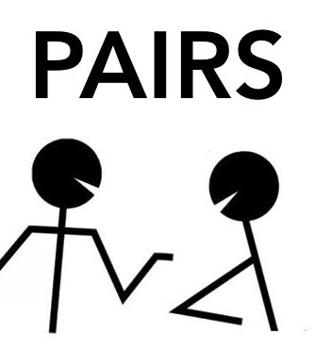
Constructive Conversation Game
PROMPT:
What do you notice in the visual text?
Rules of the game:
Each of you needs four CREATE cards
Each of you will play one card as you share your CREATE ideas. You will continue taking turns until all cards are placed in the middle.
If you’re done early repeat the process for an additional round.
Remember to use the Constructive Conversation Norms and Skills as you play the game.
Notes:
You are now going to have the opportunity to practice the Constructive Conversation Skill CREATE while playing a game.
Explain the rules of the Constructive Conversation Game to students.

Slide 15


Prompt: What do you notice in the visual text?
TEACHER COLLECTS LANGUAGE SAMPLE SPF 1.0
STUDENT VISUAL TEXT
Notes:
Display the Student Visual Text
Direct students to use their Think Time
As the students play the game, the teacher listens and selects two students who will replay the game in front of the class to serve as models.
This is an opportunity to capture a language sample.

Slide 16


CONSTRUCTIVE CONVERSATION
FISHBOWL MODEL
PROMPT: What do you notice in the visual text?
Listen actively to what two partners say to each other.
FORMATIVE ASSESSMENT– TEACHER COLLECTS LANGUAGE SAMPLE SPF 1.0
Notes:
The two selected students will replay the game in front of the class and serve as models.
Student Progress Form (SPF)-­‐‑ Constructive Conversation Language Sample The teacher will collect a language sample from the two students on the Student Progress Form (SPF)-­‐‑ Constructive Conversation Language Sample to be used in Lesson 2. The language sample must be at least four turns in length. (Each turn includes both Partner A and B sharing

Slide 17
WRAP-UP
How did we meet today’s objective of using the Constructive Conversation Skill of CREATE?
How did you:
    Use your think time?
    Use the language of the skill
  Work with your conversation partner to do the following:
    Identify three things that you did to meet today’s objective
    Share and explain the three things to your partner
Notes:
Teacher will review ELD objective.
Today we engaged in a Constructive Conversation using the Constructive Conversation Skill-­‐‑CREATE. We took turns and shared ideas based on a visual text.
Teacher will ask students the following:
● How did we meet today’s objective of using the Constructive Conversation Skill of CREATE?
● How did you:
-Use your think time
-Use the language of the skill
● Work with your conversation partner to do the following:
Identify three things that you did to meet today’s objective
Share and explain the three things to your partner
Teacher calls on three students and they tell the class what was done today.

Slide 18
Start Smart 1.0
3rd Grade
Lesson 2

Slide 19
ELD Objective
Students will be able to revise a Non-Model Conversation for the Constructive Conversation Skill- CREATE in a whole group setting and with a triad.
Notes:
Today we are going to review the Constructive Conversation Skill-­‐‑CREATE. When we create, we say what we notice about something.

Slide 20
Notes:
Let’s review the Conversation Norms Poster
Today, we will focus on:
Use the language of the skill
Use your conversation voice
**Give examples for both. Ask for student volunteers to model the two norms.

Slide 21
Conversation Norms
Notes:
Show Constructive Conversation Norms Video as a review of all norms

Slide 22
Hand Gesture and Phrase- CREATE
Sharing Our Ideas
Notes:
Review hand gesture and phrase for CREATE

Slide 23
Prompt and Response Starters
Prompt Starters:
What do you notice?
What do you think?
What is your idea?
Response Starters:
I notice…
I think…
An idea is…

Slide 25
Prompt:
What do you notice in the visual text?
TEACHER VISUAL TEXT
Notes:
Display the Student Visual Text
Direct students to use their Think Time

Slide 26
Listen to the Model Constructive Conversation
  Use your think time to study the visual text.
Listen actively to what two partners say to each other.
WHAT DO YOU NOTICE IN THE VISUAL TEXT? CITE DETAILS TO CLARIFY YOUR IDEAS.
Notes:
Provide a copy of the Model Script to the volunteer and allow time beforehand for student to review the script. Suggestions for reading the script:
● Show a video of students having the model conversation (optional)
● Student volunteer and teacher read model script
STUDENT LISTEN ACTIVELY

Slide 27
What makes this a model conversation?
Partner A: I notice a woman picking up feathers. What do you notice?
Partner A: I notice the people standing at the back looking at the woman. What do you notice?
Partner A: I notice the woman is looking at the chicken. What else do you notice?
Partner A: I notice the dog is trying to catch the feathers. What do you notice?
Partner B: I notice a dog standing on its back legs jumping at the feathers. What do you notice?
Partner B: I notice there are feathers all over the floor. What else do you notice?
Partner B: I notice that the chicken is sitting on a pile of feathers that are on the barrel. The feathers are not the same as the chicken’s feathers. What do you notice?
Partner B: I notice the woman has two feathers in her pocket.
Notes:
CREATE and CLARIFY
Model using think time and pointing at key elements of the visual text before reading the script.

Slide 28
Understanding the Skill: CREATE
Partner A: I notice a woman picking up feathers. What do you notice? CR
Partner A: I notice the people standing at the back looking at the woman. What do you notice? CR
Partner A: I notice the woman is looking at the chicken. What else do you notice? CR
Partner A: I notice the dog is trying to catch the feathers. What do you notice? CR
Partner B: I notice a dog standing on its back legs jumping at the feathers. What do you notice? CR
Partner B: I notice there are feathers all over the floor. What else do you notice? CR
Partner B: I notice that the chicken is sitting on a pile of feathers that are on the barrel. The feathers are not the same as the chicken’s feathers. What do you notice? CR
Partner B: I notice the woman has two feathers in her pocket. CR
Notes:
Teacher displays or distributes the Model Script from Lesson 1. The Model Script will be analyzed and coded for the Conversation Norms and the Constructive Conversation Skills. Use the following codes:
CR=Create
CL=Clarify
F=Fortify
N=Negotiate
Underline=language of the skill
Let’s look at the Model Script to find evidence of the skills of CREATE. How are we using the visual text to guide our conversation? Read it to yourself as I read it aloud. Let’s look at the first set of turns.
Student A speaks and Student B responds. They are taking turns. Now, let’s look for the language of the skill. Look at Student A’s response. How does Student A use the skill of CREATE? I see the language of the skill (underline as noted above). I also notice that Student A states what they notice in the visual text and prompts their partner by using the prompt starter. I know this is CREATE so I will label it with CR (Write CR next to the response).
Teacher prompts students to go through the same process with the rest of the Model Conversation. Also, student A prompts student B to create an idea.

Slide 29
Notes:
Teacher refers to the Listening Task Poster-­‐‑CREATE and read each step aloud. While you are listening to my partner and me, listen for the following:

Slide 30
Listen to the Non-Model Constructive Conversation
  Use your think time to study the visual text.
Listen actively to what two partners say to each other.
WHAT DO YOU NOTICE IN THE VISUAL TEXT? CITE DETAILS TO CLARIFY YOUR IDEAS.
Notes:
Provide a copy of the Non-Model Script to the volunteer and allow time beforehand for student to review the script. Suggestions for reading the script:
● Show a video of students having the model conversation (optional)
● Student volunteer and teacher read model script
STUDENT LISTEN ACTIVELY
STUDENTS SHOULD LISTEN ACTIVELY

Slide 31
REVIEW Non-Model
What do you notice in the visual text?
Partner A: I see a chicken.
Partner A: I see a dog too.
Partner A:
Partner A: There are chicken feathers.
Partner B: I see a chicken, too.
Partner B: There is a chicken.
Partner B: I love chicken nuggets from McDonald’s.
Notes:
Teacher displays or distributes the Non-­‐‑Model Script from Lesson 1.
Let’s look at the Non-­‐‑Model Script. How can we improve this Constructive Conversation? This was our prompt, “What do you notice in the visual text?” Here’s the visual text. Read it to yourself as I read it aloud. Think about the prompt and the language of the Constructive Conversation Skill CREATE.
Teacher will use questions and the Listening Task Poster to guide students through an analysis of what makes this a Non-­‐‑Model Constructive Conversation for the skill of CREATE. See possible responses below.
No, they did not take turns sharing their ideas because partner A spoke two times in a row, without letting partner B take a turn
At first, they responded to the prompt, but towards the end they went off topic
They did not build on each other’s ideas

Slide 32
REVISE
NON-MODEL
Note to Teacher: Consult pg. 10 of Start Smart 1.0 Lessons or Teacher Resources at end of Power point
WHOLE-GROUP/CLASS REVISED NON-MODEL
Notes:
Teacher along with students revise the text on chart paper or document reader.
Revised* Non-Model:
*text indicates what the teacher should cross out as the text is being revised.
Bold indicates language revised.
Student A:
I notice see the animals in a garden. What do you notice?
Student B:
I notice see the animals, too. They are planting. What do you notice?
Student B:A
I see notice a turtle raking the ground.
Student B:
I notice that there is a fox rake raking, too.
Student A:
I notice that there is a raccoon holding a shovel.
Student B:
I see notice a shovel on the ground.
Student A:
I notice that there is a bunny rabbit jumping.
Student B:
I like carrots. Three of the animals are working.
Refer to class revised Non-Model, have pairs read.

Slide 33
Prompt:
What do you notice in the visual text?
Notes:
Display the Student Visual Text
Direct students to use their Think Time

Slide 34

Language Sample Revision-Non-Model
You will work in a triad:
Number off from 1-3 to form a triad and select a student who will record the revision of the language sample
Read the language sample
Orally revise the language sample to improve the conversation
Use the prompt and response starters for CREATE
Be prepared to share out to the class
FORMATIVE ASSESSMENT– TEACHER COLLECTS LANGUAGE SAMPLE SPF 1.0
Notes:
Teacher will review ELD objective.
Today we revised a CREATE Non-­‐‑Model Constructive Conversation. We took turns and shared ideas based on a visual text.
Teacher asks students the following:
● How did we meet today’s objective of using the Constructive Conversation Skill of CREATE?
● How did you:
o use the language of the skill o use your conversation voice
● Work with your conversation partner to do the following:
o Identify three things that you did to meet today’s objective o Share and explain the three things to your partner
Teacher calls on three students and they tell the class what was done today.

Slide 35
WRAP-UP
How did we meet today’s objective of using the Constructive Conversation Skill of CREATE?
How did you:
    Use the language of the skill?
    Use your conversation voice?
Work with your conversation partner to do the following:
    Identify three things that you did to meet today’s objective
    Share and explain the three things to your partner

Slide 36
Start Smart 1.0
3rd Grade
Lesson 3

Slide 37
ELD Objective
ELD Objective: Students will be able to engage in a Constructive Conversation using the Constructive Conversation Skill of CREATE, by sharing ideas and taking turns based on a visual text with a partner.
Notes:
Today we are going to practice the Constructive Conversation Skill CREATE. When we observe or read something new we have many thoughts and ideas. As we engage in a CREATE conversation, our job as speakers is to create and take ownership of our ideas. As listeners our role is to value and foster them same or different ideas we hear.

Slide 38
Notes:
FOCUS is
Listen respectfully
Take turns and build on each other’s ideas
We will also establish norms to ensure good listening and speaking skills. Watch me as I model the five different conversation norms. Then you will debrief with your conversation partner by addressing the prompt: How did my partner and I demonstrate the conversation norms?
Use your think time
Say: First, we focus on and read the entire visual text. This means that we look at everything in the visual text. Then we take time to think about what we have read or seen and how it makes sense to us. In our minds, we think about the ideas we have. We might ask ourselves questions about the visual text. In our minds, we practice and say our ideas.
Demonstration: Teacher models looking at the visual text and examining it closely, nodding head, and placing index finger on the temple of his/her head to demonstrate think time.
Debrief:
Teacher: Talk with your partner. Answer the following prompt: How did I demonstrate think time? After a minute, bring the students back to share-out.
Targeted response: I saw your eyes on the text; you put your finger on your temple to show you were thinking.
Use the language of the skill
Say: First, we use the language of the skill (e.g., “My idea is,” “I think”) Then we share our ideas, we use the language of the skill to start our sentences and ask questions.
Demonstration: The teacher will select a student with whom to model the following script using the visual text selected:
Teacher: I notice…what do you notice?
Student: I notice…what do you notice?
Debrief:
Teacher: Talk with your partner. Answer the prompt: How did I use the language of the skill with my partner? After 1 minute, bring the students back to share-out.
Targeted Response: I heard the teacher and partner using the response starter, “I notice.”
Use your conversation voice
Say: Project your voice and speak clearly.
Demonstration: Teacher selects a student volunteer. They face each other and converse. The teacher uses a clear voice. The teacher and the student take turns and build on each other’s ideas.
Debrief:
Teacher: Talk with your partner. Answer the following prompt: How did my partner and I use our conversation voice? After 1 minute, bring the students back to share-out.
Targeted Response: The teacher used a clear voice; one person spoke at a time as they took turns.
Listen respectfully
Say: One way to let your partner know you are listening is to focus on your partner. Another way to let your partner know that you are listening to them is to restate, or say what your partner said. This shows respectful listening and helps you understand your partner.
Demonstration: The teacher lets the student begin the conversation using the visual text. The teacher nods and acknowledges. After the student shares, the teacher paraphrases what the student said with the following phrase: I heard you say…
Debrief:
Teacher: Talk with your partner. Answer the following prompt: How did my partner and I demonstrate respectful listening and restating? After 1 minute, bring the students back to share-out.
Targeted Response: After the first speaker stopped talking, the teacher (other partner) paraphrase what they said to show respectful listening.
Take turns and build on each other’s ideas
Say: To learn from each other, we have to share our best thinking. We listen carefully so we can add to and make our partner’s ideas clearer. Taking turns is everyone’s responsibility. The goal of Constructive Conversation is to learn from each other.
Demonstration: The teacher and a student volunteer model building on each other’s ideas using the visual text.
Debrief:
Teacher: Talk with your partner. Answer the following prompt: How did my partner and I demonstrate taking turns and building on each other’s ideas?
Targeted Response: Each partner took a turn and added to the other partner’s idea.

Slide 39
Conversation Norms
Notes:
Show Constructive Conversation Norms Video as a review of all norms

Slide 41
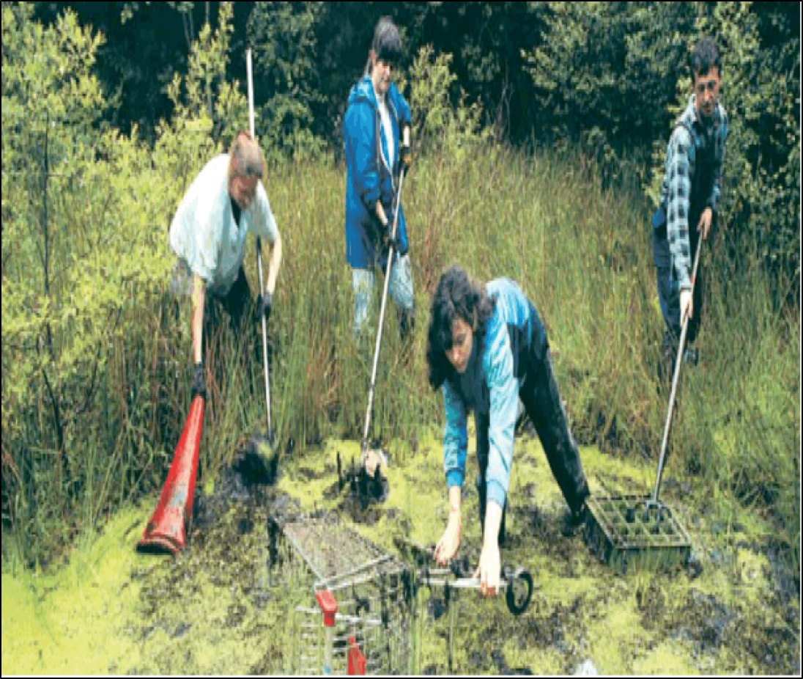
Prompt:
What do you notice in the visual text?
TEACHER VISUAL TEXT
Notes:
Display the Student Visual Text
Direct students to use their Think Time

Slide 42
Listen to the Model Constructive Conversation
  Use your think time to study the visual text.
Listen actively to what two partners say to each other.
WHAT DO YOU NOTICE IN THE VISUAL TEXT? CITE DETAILS TO CLARIFY YOUR IDEAS.
Notes:
Provide a copy of the Model Script to the volunteer and allow time beforehand for student to review the script. Suggestions for reading the script:
● Show a video of students having the model conversation (optional)
● Model with a student using the Model Script.

Slide 43
Visual Text Model
What do you notice in the visual text?
Partner A: I notice the people are working in the woods. What do you notice?
Partner A: I notice a woman grabbing something. What do you notice?
Partner A: I notice the woman has a rake and she is picking up mud. What do you notice?
Partner A: I notice they are all working together to clean up the trash. What do you notice?
Partner B: I notice they are cleaning the woods. What do you notice?
Partner B: I notice a woman picking up a dirty cone. What do you notice?
Partner B: I notice a woman with the blue jacket is scooping up trash with her rake. What do you notice?
Partner B: I notice they are using tools. What do you notice?
Notes:
Teacher will use questions and the Listening Task Poster to guide students through an analysis of what makes this a Model Constructive Conversation for the skill of CREATE.

Slide 44
Notes:
Teacher refers to the Listening Task Poster-­‐‑CREATE and read each step aloud. While you are listening to my partner and me, listen for the following:

Slide 45
Listen to the Non-Model Constructive Conversation
  Use your think time to study the visual text.
Listen actively to what two partners say to each other.
WHAT DO YOU NOTICE IN THE VISUAL TEXT? CITE DETAILS TO CLARIFY YOUR IDEAS.
Notes:
Provide a copy of the Non-Model Script to the volunteer and allow time beforehand for student to review the script. Suggestions for reading the script:
● Show a video of students having the model conversation (optional)
● Model with a student using the Non-Model Script.

Slide 46
Visual Text Non-Model
What do you notice in the visual text?
Partner A: What is your idea?
Partner A: They are cleaning something.
Partner A: I wish I had a scooper like the one the lady has.
Partner A: Let’s tell the principal we need a scooper.
Partner B: I think they are cleaning something, too.
Partner B: One idea is that they are picking up trash.
Partner B: My mom can let us use her scooper.
Partner B: That reminds me of all the trash in the playground.
Notes:
CREATE and CLARIFY
Model using think time and pointing at key elements of the visual text before reading the script.

Slide 47
Constructive Conversation Game
PROPMT:
What do you notice in the visual text?
Rules of the game:
Each of you needs four CREATE cards
Each of you will play one card as you share your CREATE ideas. You will continue taking turns until all cards are placed in the middle.
If you’re done early repeat the process for an additional round.
Remember to use the Constructive Conversation Norms and Skills as you play the game.
Notes:
You are now going to have the opportunity to practice the Constructive Conversation Skill CREATE while playing a game.
Explain the rules of the Constructive Conversation Game to students.

Slide 48
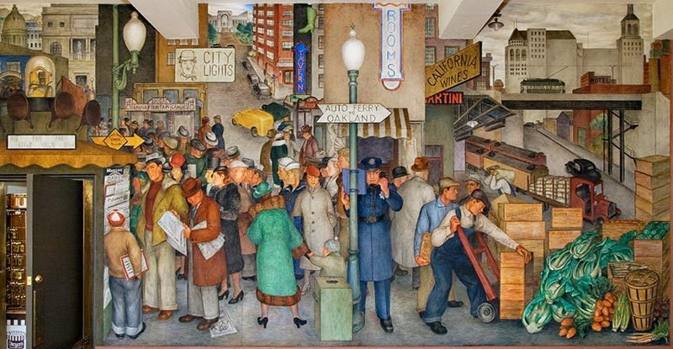
Prompt: What do you notice in the visual text?
TEACHER COLLECTS LANGUAGE SAMPLE SPF 1.0
STUDENT VISUAL TEXT
Notes:
Display the Student Visual Text
Direct students to use their Think Time
As the students play the game, the teacher listens and selects two students who will replay the game in front of the class to serve as models.
This is an opportunity to capture a language sample.

Slide 49
CONSTRUCTIVE CONVERSATION
FISHBOWL MODEL
PROMPT: What do you notice in the visual text?
Listen actively to what two partners say to each other.
FORMATIVE ASSESSMENT– TEACHER COLLECTS LANGUAGE SAMPLE SPF 1.0
Notes:
The two selected students will replay the game in front of the class and serve as models.
Student Progress Form (SPF)-­‐‑ Constructive Conversation Language Sample The teacher will collect a language sample from the two students on the Student Progress Form (SPF)-­‐‑ Constructive Conversation Language Sample to be used in Lesson 2. The language sample must be at least four turns in length. (Each turn includes both Partner A and B sharing

Slide 50
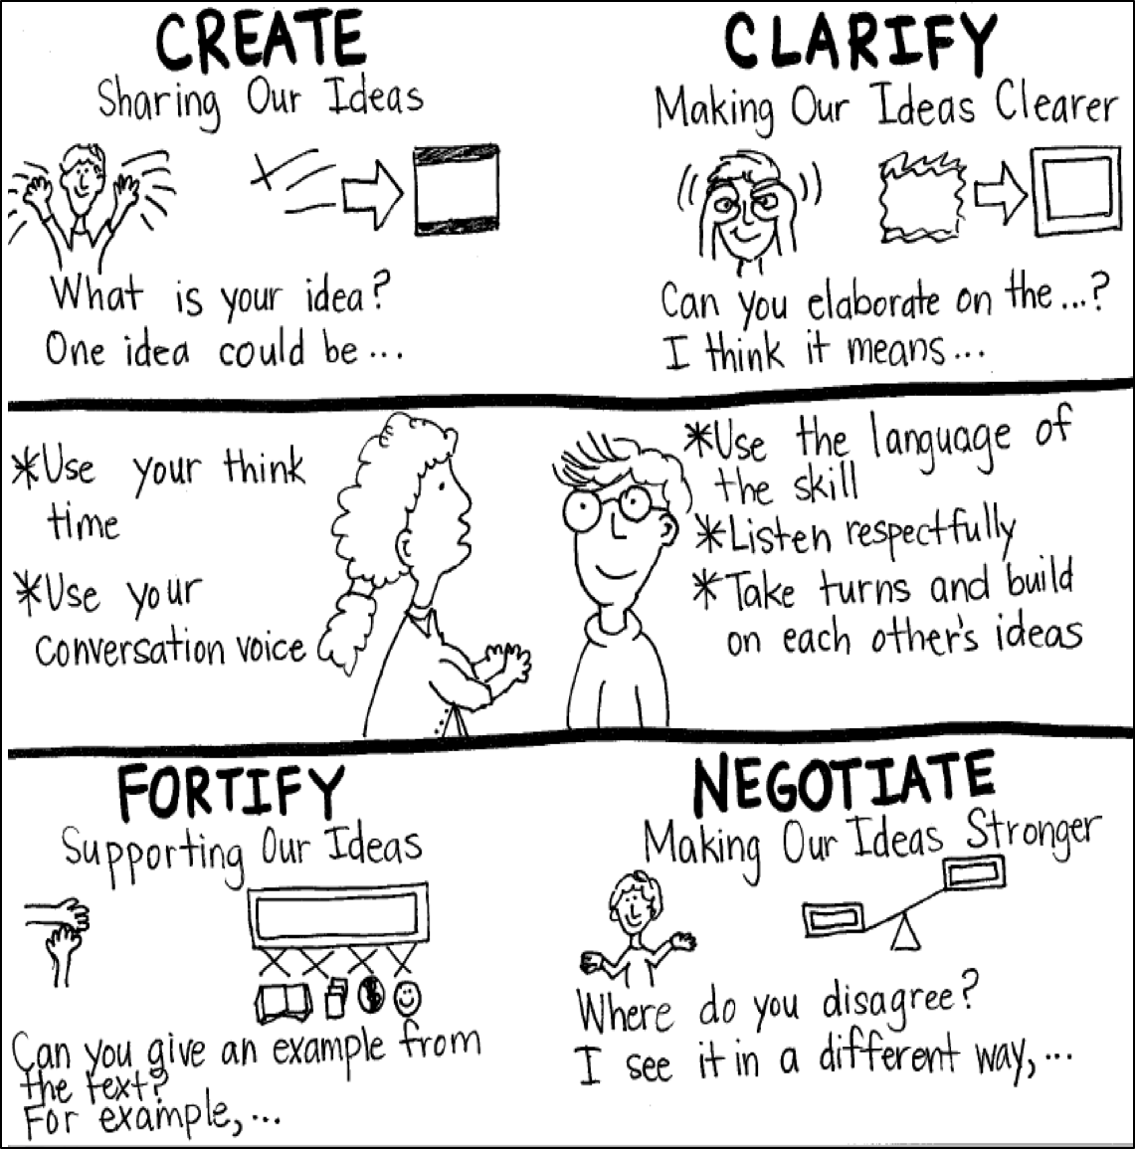
Model Creating Class Constructive Conversation Poster
Sample
Notes:
Teacher models creating a class Constructive Conversation Poster (see resources). Teacher elicits student responses to develop a class poster that illustrates their understanding of the CREATE skill and Conversation Norms.
The poster should have only prompt and response starters used by the students for the Constructive Conversation Skill CREATE such as:
▪ What do you notice?
▪ I notice...

Slide 51
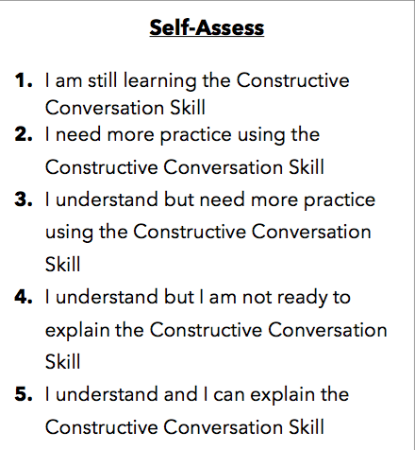
Notes:
Teacher will review the Constructive Conversation Skill CREATE
Students will self-assess answering the prompt
Teacher may select a conversation pair to share out.
EXAMPLE:
Student: I rated myself a 3 because…
Teacher: What can you do to move to a 4?

Slide 52
Teacher Resources

Slide 53
CREATE Non-Model Revision

